Slide 1
ATHLET MEDIA APPREARNCE SCHEDULER POC :

Slide 2
Team byte hogs
TEJASHWINI VR : 3BR22CS173
SNEHA DEVALE : 3BR22CS164
SHRIDEVI : 3BR22CS158
YASHODHA : 3BR22CS187

Slide 3
Introduction to the project :

Slide 4
content
organize_ media_appearances (athlete_id): Organize media appearances for athletes.
1.Classes Defined
MediaSchedule - Represents a media schedule.
Athlete - Represents an athlete.
Scheduler - Central class for managing schedules and relationships.
Unittest class- to test a unit of source code.
2. Key Functionalities- CRUD operations for schedule,sorting and organizing schedules,managing relationships with media outlets.
3. Data Structures Used
Lists for storing collections of objects.
Dictionaries for efficient look-up and relationships

Slide 5
Module description :
The Athlete class : it provides a blueprint for creating objects that represent athletes. Each instance of this class encapsulates information about a specific athlete, including their unique identifier (athlete_id), name (name), and the sport (sport) they participate in.
The MediaSchedule class : is designed to manage and organize media schedules associated with individual athletes within a software system. It encapsulates information related to scheduled media appearances or events for athletes, facilitating efficient tracking and management of media engagements.
The Scheduler class : serves as a central component for managing scheduling operations within a software system. It provides functionality for organizing various schedules, including media engagements, events, or appointments. Additionally, it facilitates the coordination of schedules for athletes and media outlets.

Slide 6
The TestScheduler class: is a vital component in software testing environments. It's designed to facilitate the scheduling, organization, and execution of tests within a testing framework or environment. This class serves as a central hub for managing various test cases, ensuring they run efficiently, and collecting results for analysis.
create_media_schedule(schedule_id, athlete_id, date, media_outlet): Creates a new media schedule entry with the provided details and adds it to the list of schedules.
read_media_schedule(schedule_id): Retrieves the media schedule entry corresponding to the given schedule ID.
update_media_schedule(schedule_id, updated_data): Updates the details of the media schedule entry identified by the given schedule ID with the provided updated data.

Slide 7
delete_media_schedule(schedule_id): Deletes the media schedule entry associated with the given schedule ID from the list of schedules.
Organize_media_appearances(athlete_id): Retrieves all media appearances scheduled for the athlete with the provided athlete ID.
setUp(self): This method is called before each test method to set up the testing environment. It creates an instance of the Scheduler class and initializes it with sample data, including media schedules and athlete information.
test_create_media_schedule(self): This method tests the create_media_schedule method of the Scheduler class. It verifies whether the method correctly adds new media schedule entries to the scheduler's list of schedules.

Slide 8
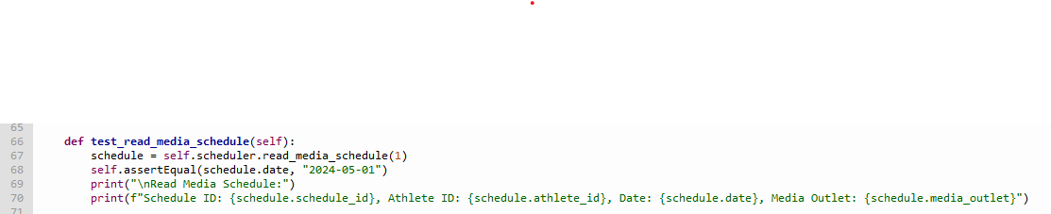
test_read_media_schedule(self): This method tests the read_media_schedule method of the Scheduler class. It checks whether the method correctly retrieves a media schedule entry based on the provided schedule ID.
test_update_media_schedule(self): This method tests the update_media_schedule method of the Scheduler class. It verifies whether the method correctly updates the details of a media schedule entry based on the provided schedule ID and updated data.

Slide 9
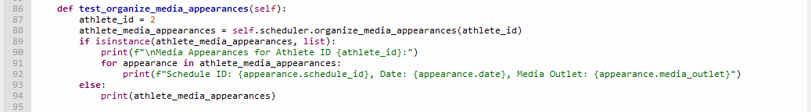
test_delete_media_schedule(self): This method tests the delete_media_schedule method of the Scheduler class. It checks whether the method correctly removes a media schedule entry from the scheduler's list of schedules based on the provided schedule ID.
test_organize_media_appearances(self): This method tests the organize_media_appearances method of the Scheduler class. It verifies whether the method correctly retrieves all media appearances scheduled for a specific athlete based on the provided athlete ID.

Slide 10
unittest.main() is a method provided by the unittest module, which is Python's built-in testing framework.The verbosity parameter controls the amount of detail displayed in the test results output.
It accepts three levels of verbosity:
0: Quiet mode, only displays the total number of tests and errors.
1: Default mode, displays a dot for each successful test and F for each failed test, along with the total counts.
2: Verbose mode, displays the name of each test and its result, including successful tests.In your script, unittest.main(verbosity=0) is set to quiet mode (verbosity=0), meaning it will only show the total number of tests run and any errors encountered, without detailed test-by-test output.

Slide 11
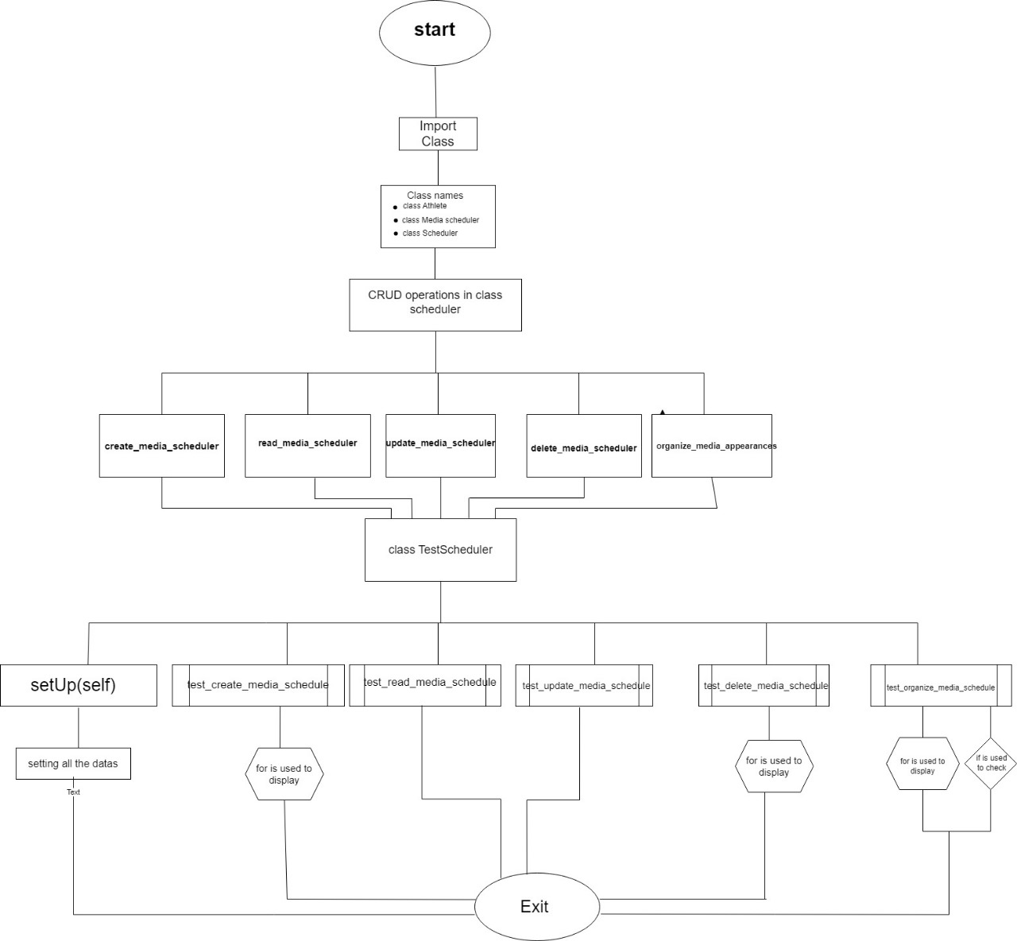
Flow chart:

Slide 12
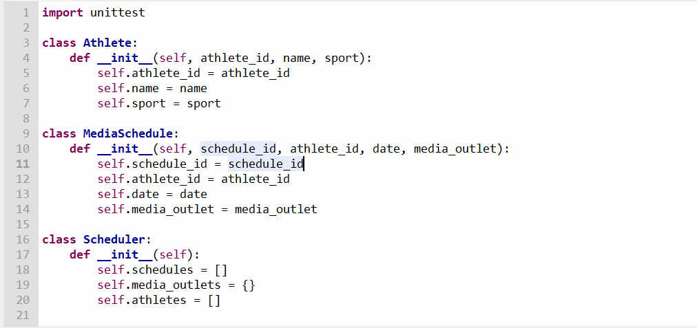

Slide 13
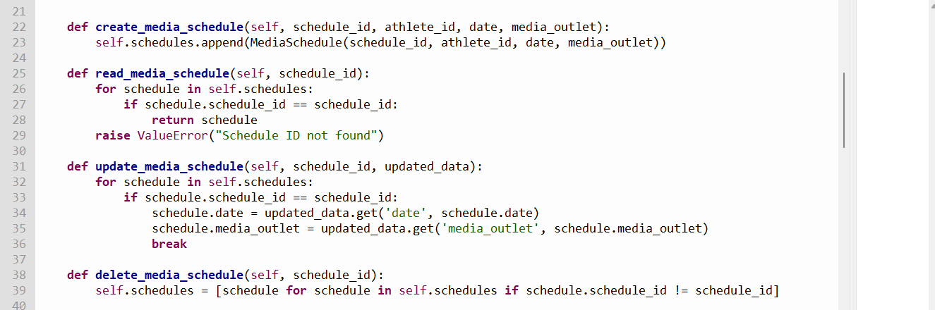

Slide 14
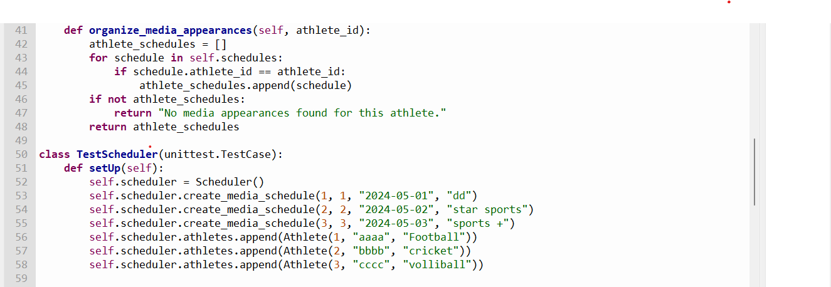

Slide 15
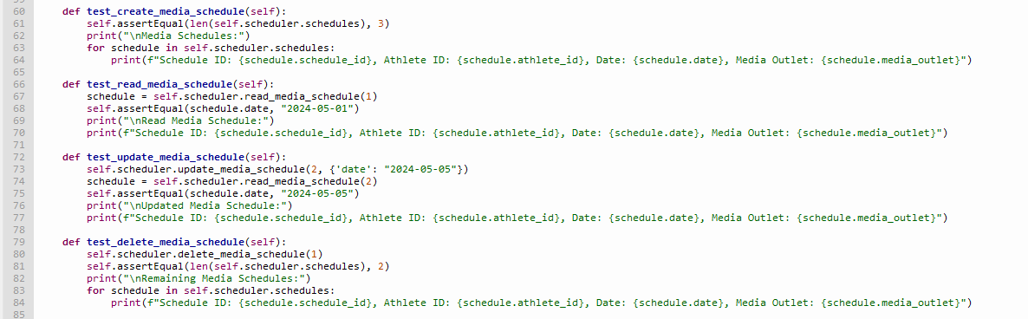

Slide 16
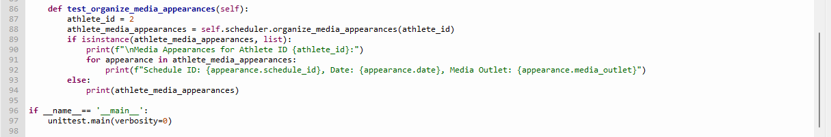

Slide 17
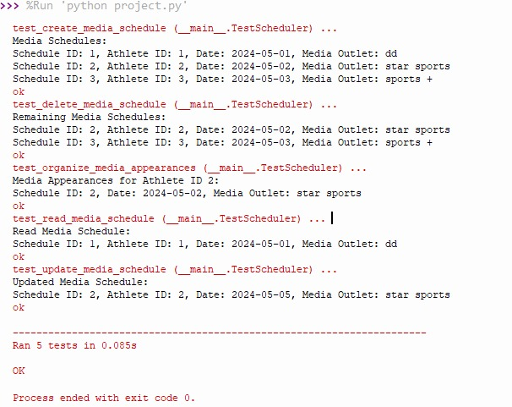

Slide 18
summary
The Athlete class represents an athlete with attributes such as athlete_id, name, and sport.
The MediaScheduler class represents a media schedule with attributes such as schedule_id, athlete_id, date, and media_outlet.
The Scheduler class manages media schedules and athletes.
It has methods to create, read, update, and delete media schedules, as well as organize media appearances for a specific athlete.
The TestScheduler class contains unit tests for the methods in the Scheduler class to ensure they work as expected.
Overall, the code provides a basic framework for managing media schedules for athletes, including functionality for CRUD operations and organizing media appearances.

Slide 19
BIBLIOGRAPHY
https://chat.openai.com/
https://apphttps://app.diagrams.net/.diagrams.net/
Googlr colab
Thonny
Google
GITHUB ACCOUNT :
https://github.com/shridevi-23
https://github.com/tejashwinivr/BITM
https://github.com/Snehadevale
https://github.com/yashodhakampli

Slide 20


